Slide 1
ORNAMENTA GARDENING

Slide 2
ORNAMENTAL GARDENING
Branch of horticulture which deals with plants having aesthetic value.
It includes flowering trees,herbs,shrubs, annuals,floricrop,palm and cycads,ferns, grasses, Bamboo, reeds, cacti, succulents etc.
GARDEN-Garden is a place where plants embellished with plants of valuable and pleasurable nature.
FEATURES OF GARDEN—
Mughal Garden
Japanese Garden
English Gaden

Slide 3
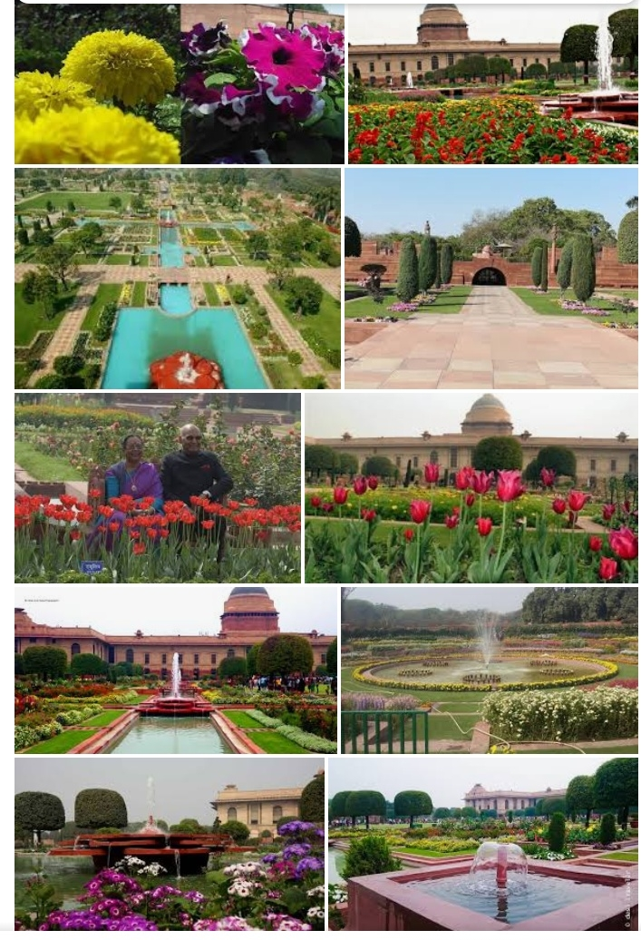
MUGHAL GARDEN
Main features
Terraces
Running water
Baradari
High protecting Wall Terminal building
E.g Mughal garden,New Delhi

Slide 4
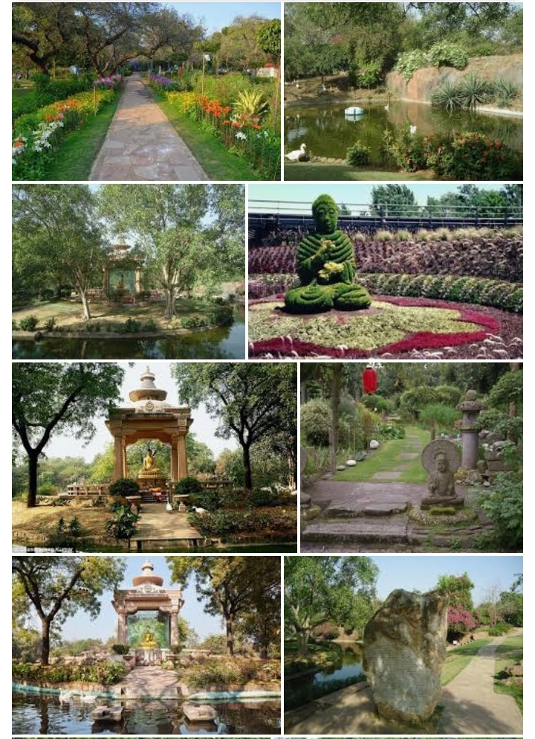
JAPANESE GARDEN
Main features
Garden pagoda,
Garden lanterns
Dry landscape,,
EE.g.Buddha Jayanti park ,New Delhi

Slide 5
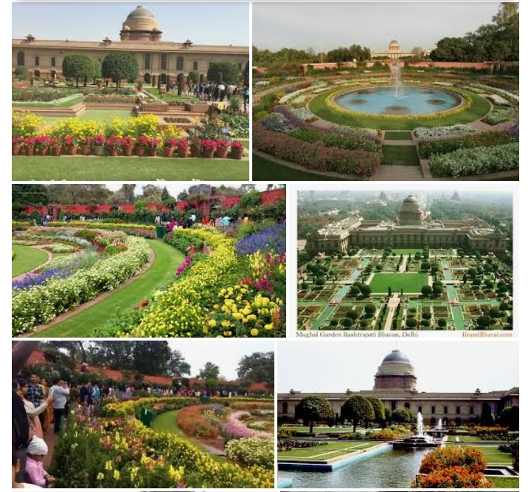
ENGLISH GARDEN
Main features
Herbaceous border
Cottage garden
Lawn
Rockery
Example Persian garden, Rashtrapati garden,Tea garden

Slide 6
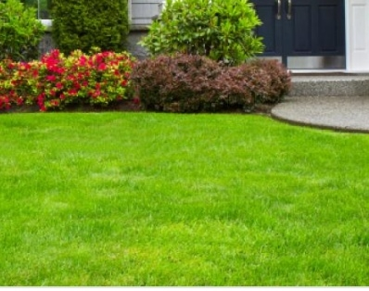
LAWN
The green carpet for the landscape maintained by growing and mowing grass.
Regarded as “Heart of garden”.
No garden is complete without lawn
Suitable lawn grasses
Cynodon dactylon
Manilla grass
Korean grass etc.

Slide 7
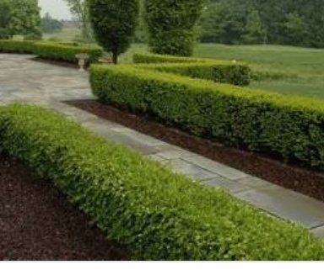
HEDGE
Shrubs or tree planted at regular intervals to form a continuous screen is termed as hedge.
Provide a natural background to a gaeden
TYPES
Tall protective-
, about 1-3 meters
E.g. Carissa carandus,Bougainvelia etc
2.Dwarf protective-
About 1 meters
E.g.Opuntia,Agave etc
3.Tall ornamental- about 3-4meters.e.g.Techoma stans,Ficus retusa etc.

Slide 8
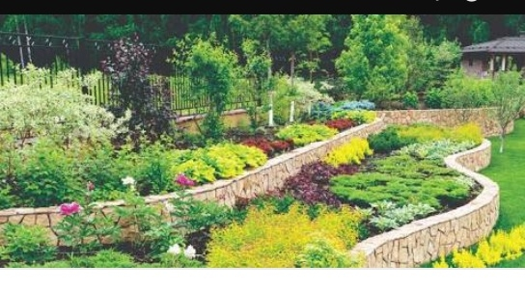
EDGE
Plantin of low growing plants along the paths,roads,flowers beds,lawns etc.for demarcation and beautification is termed as edging.
Types of edging
Formal or Mechanical
Informal or loving
A strip of grass of 60cm width is used.
E.g. Coleus,Pilea, miniature roses etc.

Slide 9
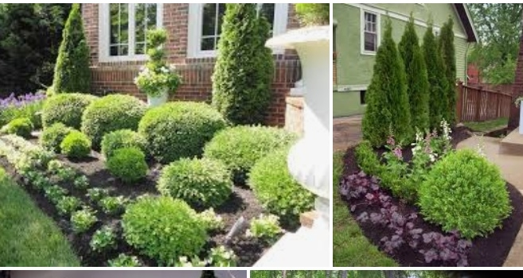
SHRUBS
Perennials plants having many indistinct woody stems arising from the base of the plant.
Usually .5 to 4.0 metres.
Types
Foliage-
Acalypha
Dracaena
Ficus retusa.etc
Flowering-
Duranta
Hibiscus
Lantana camara etc

Slide 10
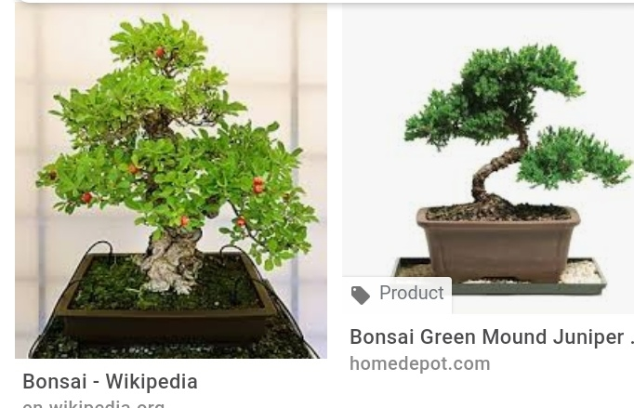
BONSAI
Art of growing and training of plant to a miniature form having a natural look of old age.
Japanese art.
Optimum size may be 30 to 60cm.
Suitable plants
Ficus species Bougenwelia
Casuarinas etc.

