Slide 1
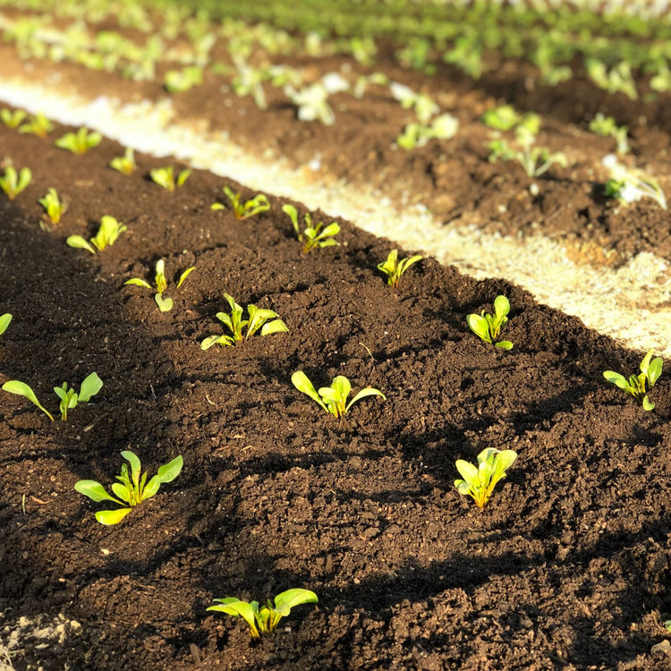
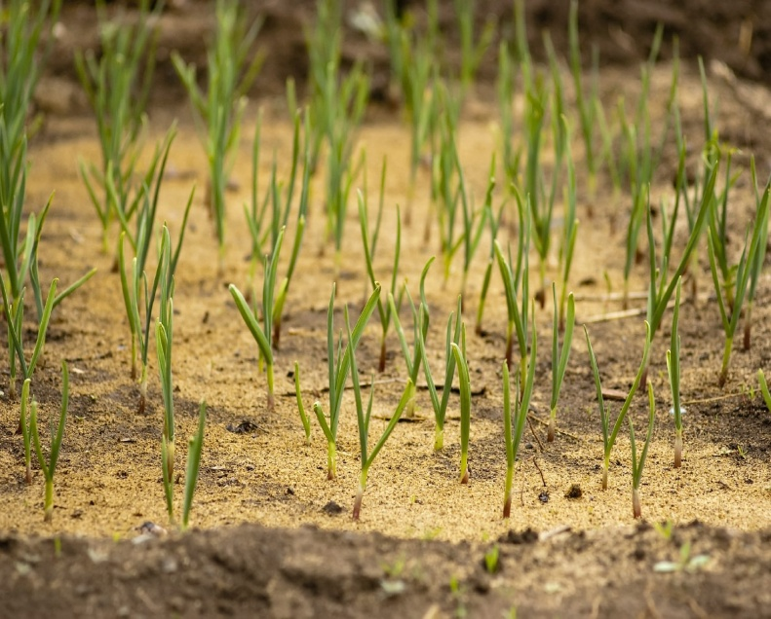
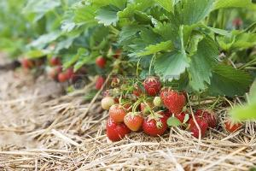
WELCOME

Slide 2
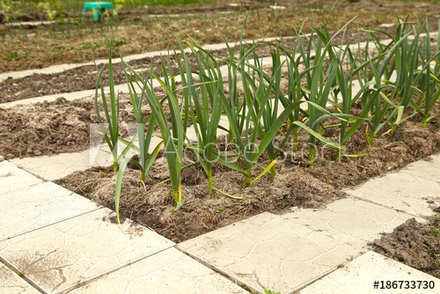
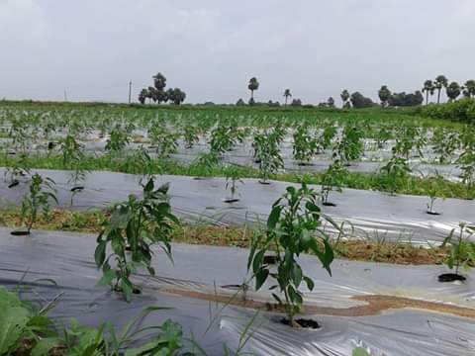
ROLE OF MULCHING IN VEGETABLE PRODUCTION
Department of Horticulture
Government Degree College, Jakkhini Varanasi

Slide 3
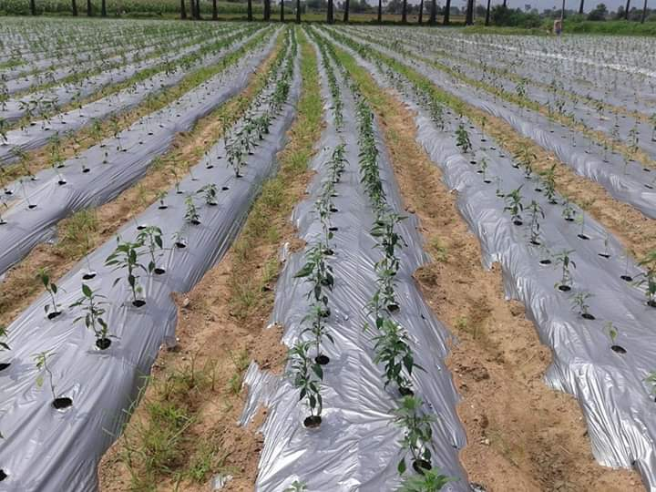
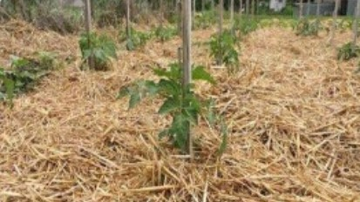
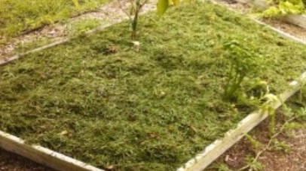
What is mulching ?
Mulching is the process of covering soil around the plants with an organic or synthetic material to create congenial condition for the plant growth, development and efficient production. “This practice helps to retain soil moisture, prevents weed growth and enhances soil structure.”

Slide 4
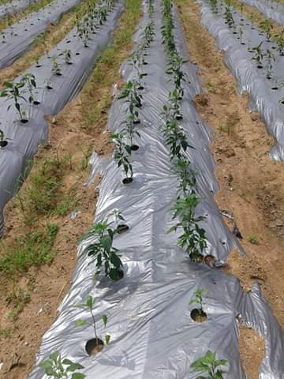
Mulches
A.) Organic Mulches
B.) Inorganic Mulches

Slide 5
Organic Mulches
a.) Grass
b.) Paddy Straw
c.) Saw Dust
d.) Sugarcane Trash
e.) Compost
f.) News Paper

Slide 6
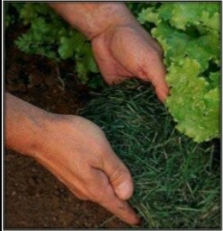
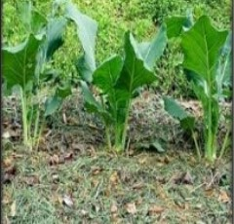
GRASS
Grass has low C:N ratio.
Later on, grass releases nitrogen to the crops.
This nitrogen helps in promoting photosynthesis and general plant health.
This is one of the most abundantly and easily available mulch materials across the country.

Slide 7
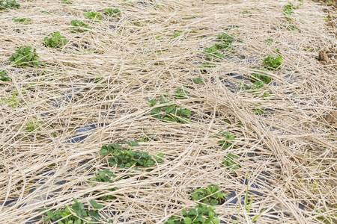
Straw
Paddy and wheat straw are commonest mulching materials used for fruit and vegetable production.
Though straw is poor in nutrient value but after decomposition, it makes soil more fertile.
Among organic mulching materials, straw has a long life in comparison to other mulches.
( grasses , leaves )
Paddy straw has an unique property of not absorbing water, so water is easily available to plants.

Slide 8
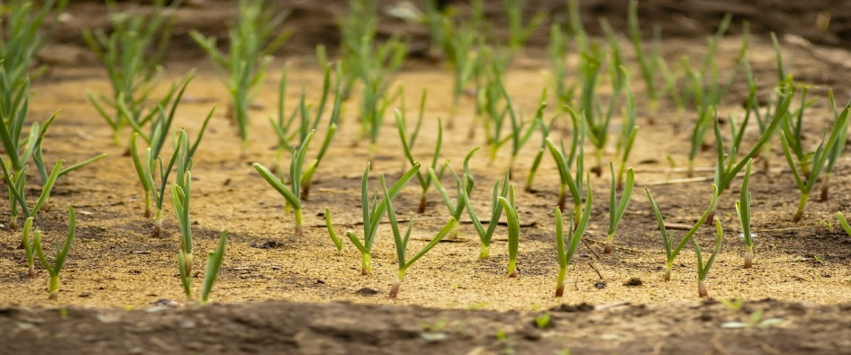
SAW DUST
It has high C:N ratio. It requires nitrogen from the soil for decomposition. However, it retains the moisture for longer periods.
Saw dust is a small granular chip wood that is obtained as the finished product in the saw mills.
It decomposes slowly. Being acidic in nature, it should not be used in acidic soil.
It is poor in nutritive value as it contains only half the nutrients of straw.

Slide 9
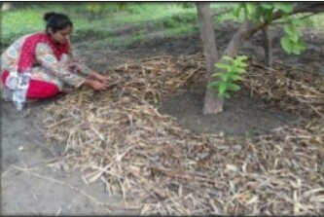
SUGARCANE TRASH
After removal of juice from the sugarcane, the residue i.e. sugarcane trash, is used for mulching.
It helps to tide over the drought.
It conserves moisture and reduces weed growth.
This type of mulching should be avoided in areas where there is incidence of termites.

Slide 10
COMPOST
The compost is one of the best mulch materials.
It increases microbial population, improver the soil structure and provides nutrients.
It is the excellent material for improving the health of soil.

Slide 11
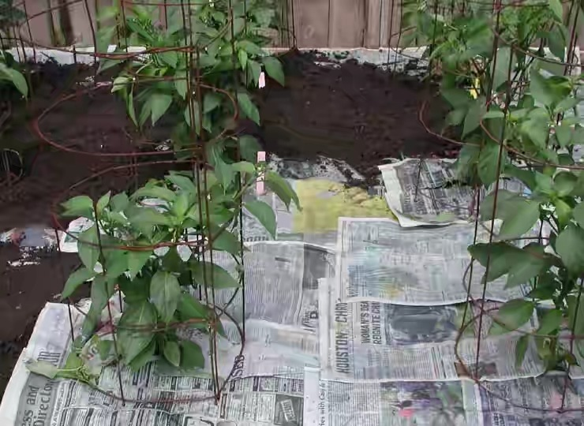
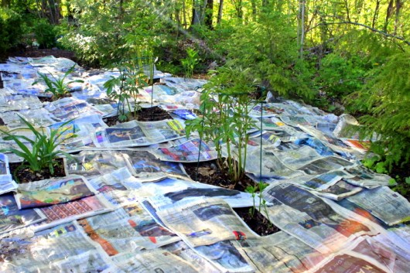
NEWS PAPER
Newspaper mulching helps to control weeds.
The application of newspaper mulch should be avoided on a windy day.

Slide 12
Inorganic Mulches
Plastic Mulch :-
There are two type –
Photo-degradable plastic mulch-
This type of plastic mulch film gets destroyed by sun light in a shorter period.
2. Bio-degradable plastic mulch-
This type of plastic mulch film is easily degraded in the soil over a period of time.

Slide 13
Generally the following types of plastic mulch films are used in Horticultural crops
Black plastic film:-
It helps in conserving moisture, controlling weed and reducing outgoing radiation.
Reflective silver film:-
It generally maintains the root-zone temperature cooler.
Transparent film:-
It increases the soil temperature and preferably used for solarization .

Slide 14
Merits of Mulching
1. Reduces evaporation
2. Reduces weed growth
3. Reduces soil compaction
4. Insect management strategies
5. Increase in plant growth

Slide 15
7. Cleaner vegetable produce
8. Reduces fertilizer leaching
9. Earlier harvest
10. Frost protection
Merits of Mulching
6. Increase in soil temperature

Slide 16
Demerits of Mulching
Greater initial cost
Spread of the diseases
Labor intensive
Increases crop/weed competition

Slide 17
CONCLUSION
It is essential to find ways to increase the yield lessen the cost of production.
Mulching, is thus, one of the most important cultural practices which increase growth, yield and quality of fruits and vegetables crops .
Due to multiple beneficial effects by all types of mulches including organic and inorganic, mulching becomes an inevitable in agriculture production.

Slide 18
THANK YOU !

